Slide 1
Suicide Ideation Prediction from Social Media Conversations
Arnav Goel (2021519)
Medha Hira (2021265)
Siddharth Rajput(2021102)

Slide 2
Motivation
Addressing Rising Suicide Rates
In recent years, we've witnessed a concerning rise in suicide rates, with a 36% increase from 2000 to 2021 (Source).
This alarming trend emphasizes the pressing need for effective prevention and intervention strategies.
The Impact of Mental Health Issues
Suicide doesn't just affect individuals; it has a profound emotional and psychological impact on families and communities.
The mental health crisis is an issue that can't be ignored.
Importance of Timely Detection
Recognizing suicidal thoughts at their early stages can offer the potential to thwart individuals from progressing to the dire precipice of suicide attempts.
Early intervention can save lives.

Slide 3


Motivation
Using Social Media for Early Intervention
Today, many individuals express their feelings and thoughts on social media platforms, often under the cloak of anonymity.
There's an opportunity to validate the presence of suicide ideation by analyzing social media posts, making it a valuable resource for early intervention.

Slide 4
Literature Review
Suicidal Ideation Detection Methods (Ji et al. 2020):
Classified into clinical approaches and machine learning techniques.
Examined domain-specific applications from various data sources.
Relationship Between Suicidal Ideation and Suicide (McHugh et al. 2019):
Found that individuals’ expression of suicidal ideation is indicative of their psychological distress.
Comparative Analysis of Suicidal Ideation Detection (Haque et al. 2022):
Evaluated DL classifiers and traditional ML approaches.

Slide 5
Literature Review
Depression and Suicide Analysis using Machine Learning and NLP (Jain et al. 2022):
Use hybrid deep learning and ML for suicidal ideation detection. It achieved high accuracy using text analysis and feature-based classification.
Suicide Risk Assessment using Machine Learning and Social Networks (Sanchez et al. 2022):
Reviewed methods for feature extraction and commonly used techniques.
Concluding Remarks:
The literature review lays the foundation for our ongoing research.
Identifying critical insights and future directions to further our work.

Slide 6
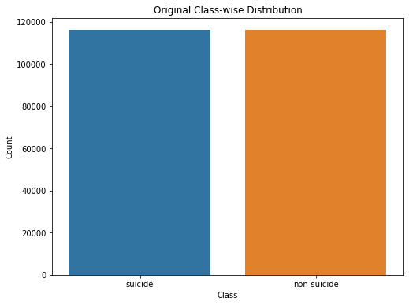
Dataset Overview
Introduction:
Data sourced from Kaggle, i.e. Suicide and Depression Detection.
Dataset inspired from the University of Maryland Reddit Suicidality Dataset which is a valuable resource for studying suicide risk assessment and prevention.
Dataset Characteristics:
Collection of reddit posts under the sub-reddit “r/SuicideWatch” from the years 2009 to 2021.
Consists of 287000 posts labelled as “suicide” or “non-suicide”

Slide 7
Data Preprocessing & EDA
Text Pre-processing:
Removal of non-ASCII characters such as emojis
Removal of URLs
Masking Usernames and Social Media Handles
Punctuation Removal
Stopword Removal: Commonly occurring insignificant words
Lowercasing of Text
Exploratory Data Analysis:
Word Frequency Analysis
Post Length Analysis
Word Clouds.

Slide 8
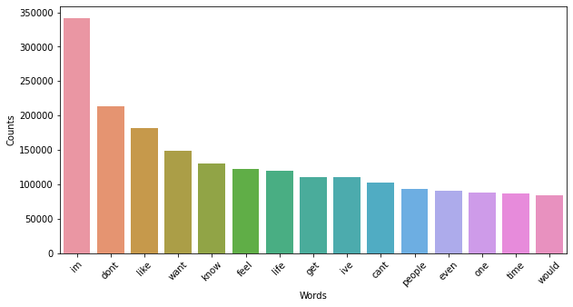
Data Exploration
Word Frequency Analysis
This shows the frequency of the most commonly occurring words in the entire dataset after pre-processing.
This shows that the words are general and simply looking will not help us predict the class of the data.

Slide 9
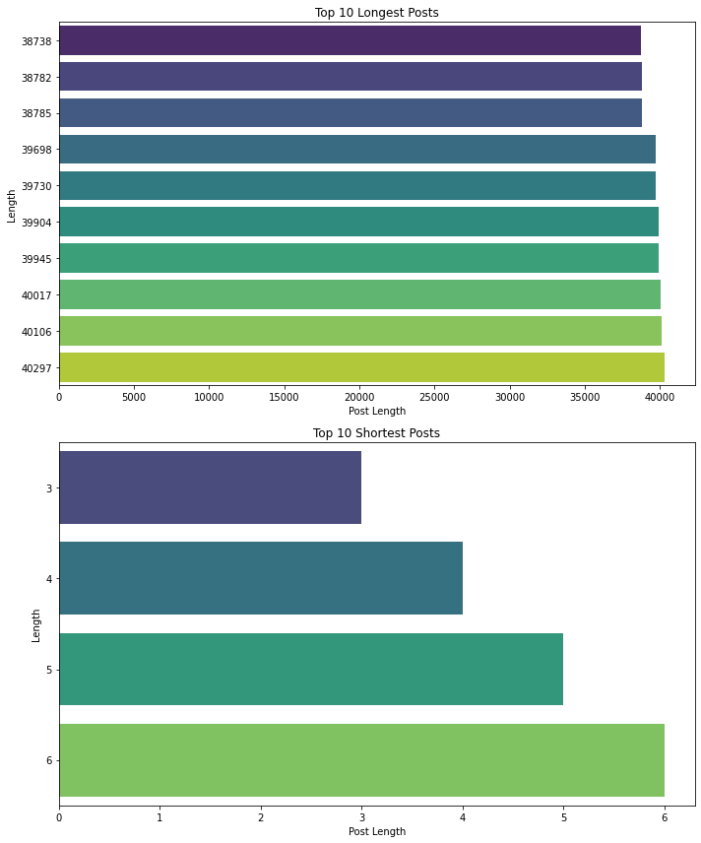
Data Exploration
Post Length Analysis
This shows the length of the longest and shortest posts, highlighting the diversity in the dataset.

Slide 10
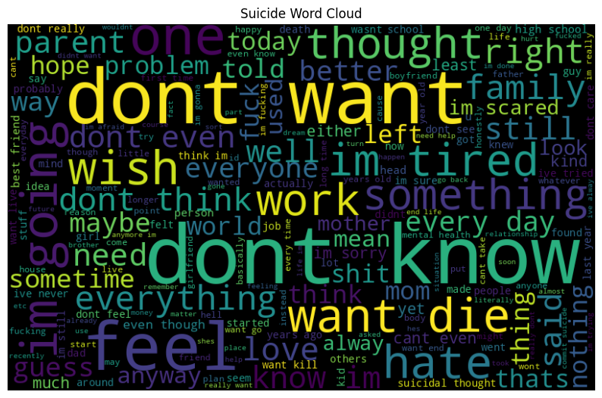
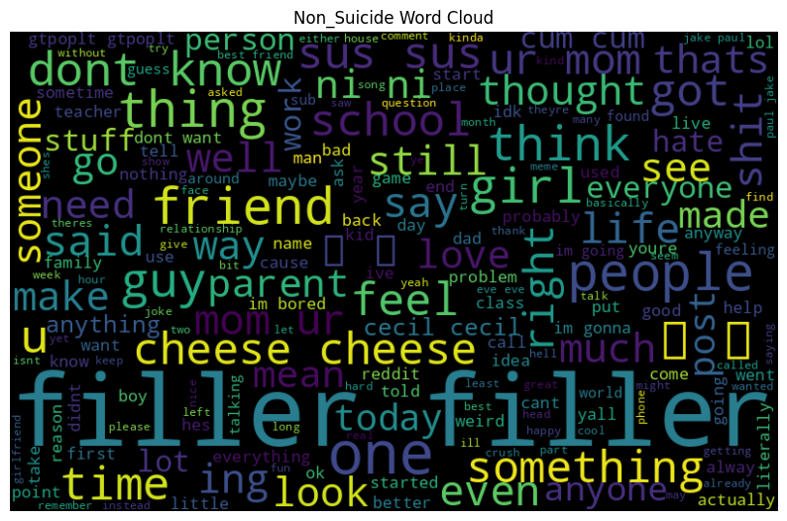
Data Exploration
Word Clouds
This shows the word clouds for both classes respectively. These word clouds show that the words in both classes are generic.
They are words humans would associate with death, suicide and trauma. Thus, it is not possible to predict suicidal ideation by just simply looking at words in the tweet.

Slide 11
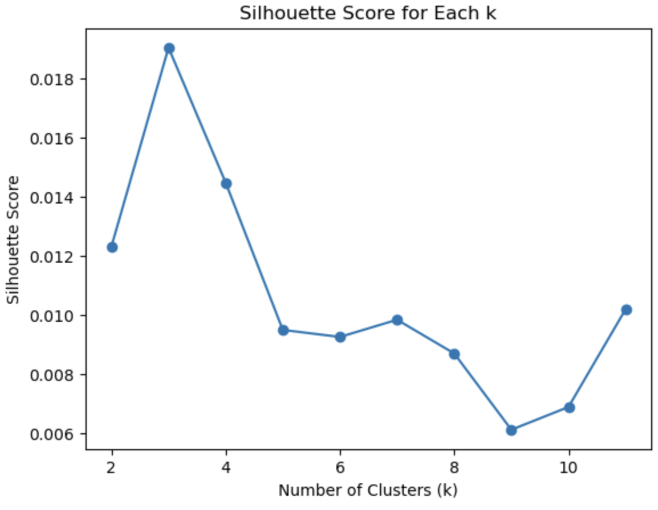
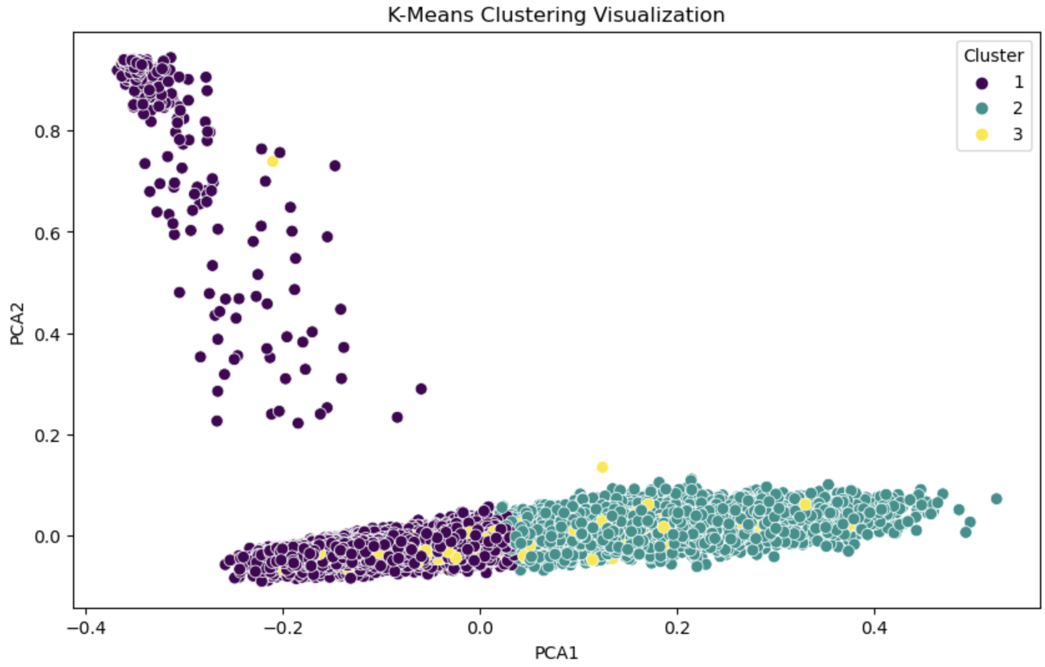
K-Means Clustering
First, we plotted the silhouette score for each k between 2 and 12 (left). Here, we see that k = 3 has highest silhouette score.
Choosing k=3 as optimal, we have plotted the k-means clustering (right).

Slide 12
Methodology - Data Preparation
Data Sampling
Out of a dataset consisting of 287000 posts, we randomly selected 15,000 posts from each class to create a custom dataset with 30,000 samples.
Training and Testing Split
Divided the dataset into training and testing sets with a 75:25 split.
Resulted in 22,500 samples for training and 7,500 samples for testing.
For each model, we perform 5-fold cross validation to find the best hyperparameters.

Slide 13
Methodology - Word Embeddings
Word2Vec
Purpose: Captures semantic relationships and contextual information between words. Embedding Size: 100 Key Feature: Converts text data into word embeddings by capturing the semantic relationships and the context.
GLoVe (Global Vectors for Word Representation)
Purpose: Creates embeddings based on the global statistical information of a corpus. Key Feature: Creates dense word embeddings using the global occurrence of words and also balances local semantics

Slide 14
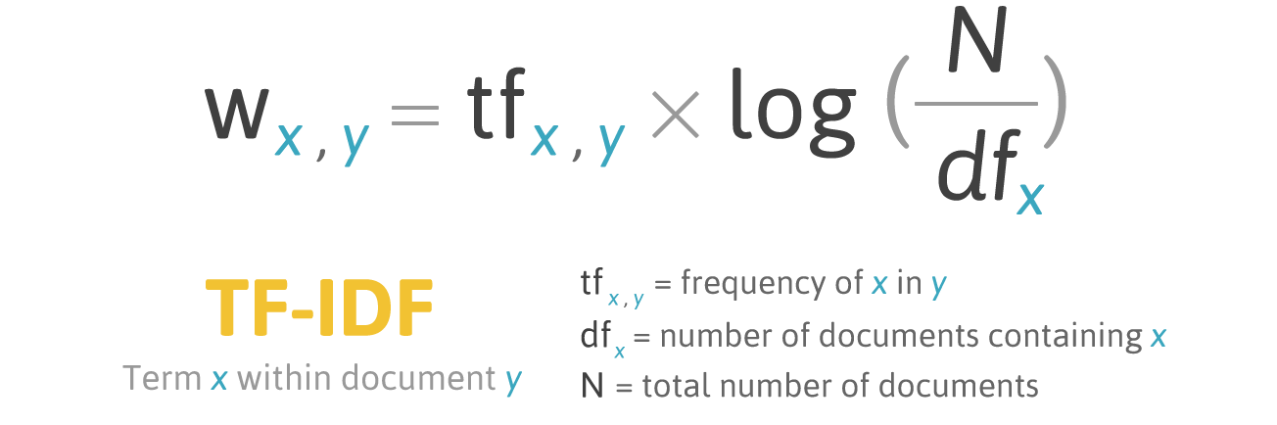
Methodology - Word Embeddings
TF-IDF (Term Frequency-Inverse Document Frequency)
Purpose: Measures the importance of a term in a document relative to a corpus. Embedding Size: 1000 Key Feature: Weighted combination of term frequency in a document and inverse document frequency in the corpus. It evaluates the importance of a word in a document relative to a collection of documents in comparison to its frequency.

Slide 15
Methodology - Word Embeddings
Transformer-Based Embeddings
BERT (Bidirectional Encoder Representations from Transformers) Purpose: Understands context by looking at words from both the left and the right in a sentence. Key Feature: Pre-trained on large corpora, facilitates transfer learning. Bidirectional context capture.
Sentence-BERT
Purpose: BERT adapted for sentence embeddings. Faster performance in similarity tasks. Key Feature: Fine-tuned on specific tasks such as sentence similarity. Yields sentence-level embeddings instead of word/token embeddings.

Slide 16
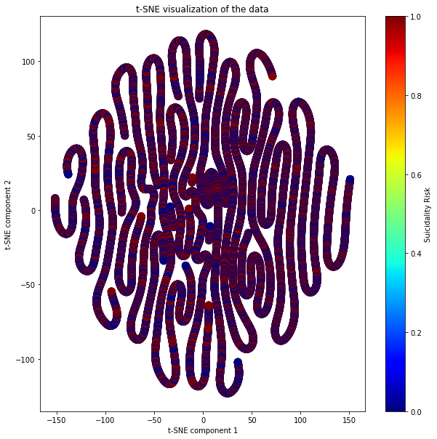
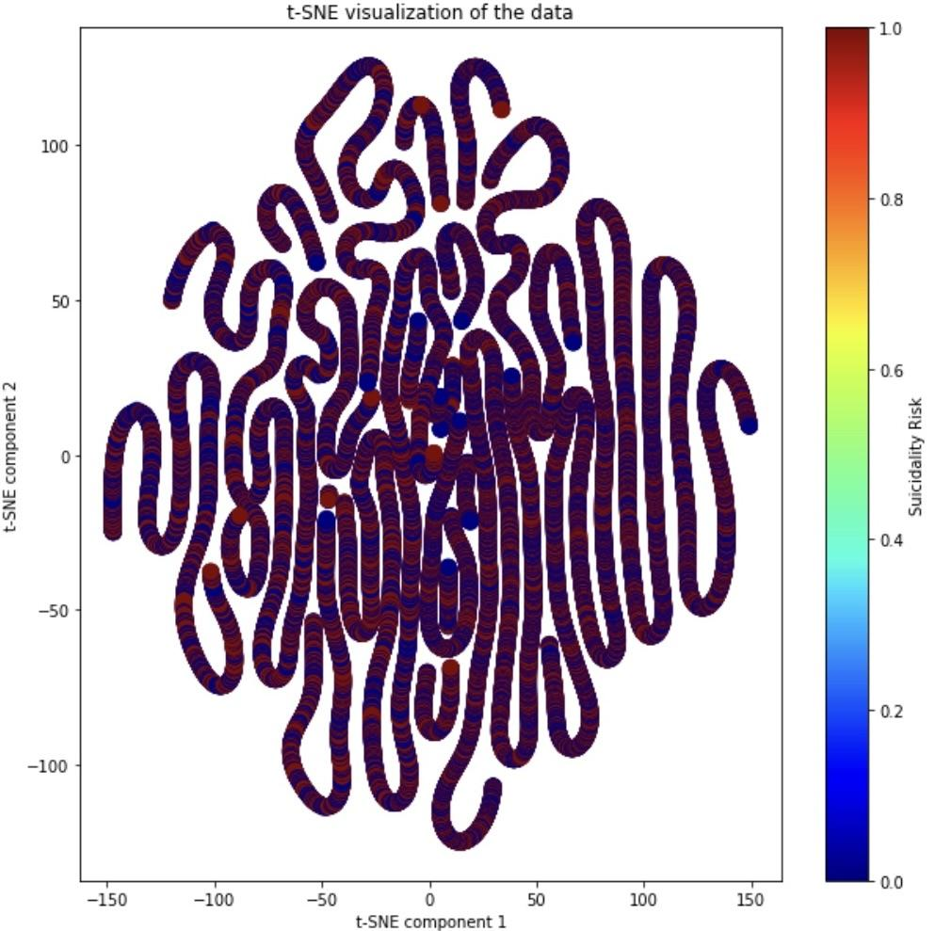
Methodology - Word Embeddings
We use TF-IDF embeddings of size 1000 and Word2Vec embeddings of size 512 for our experiments going forward.
Remaining embeddings are dumped.
We perform t-SNE dimensionality reduction to visualise the separation.
TF-IDF
Word2Vec
t-SNE

Slide 17
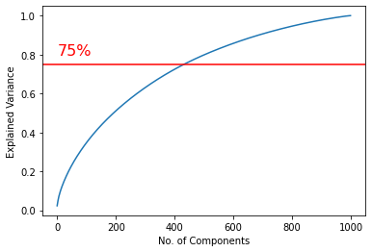
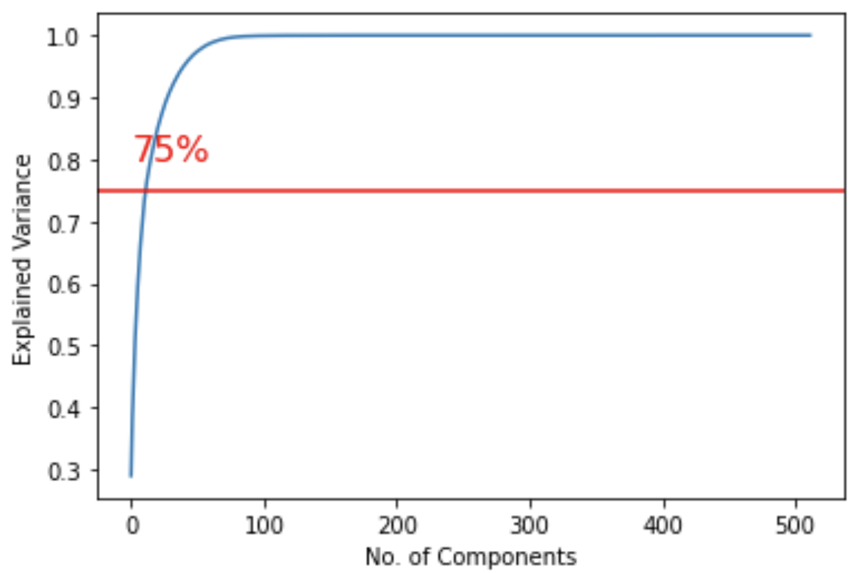
Methodology - Dimensionality Reduction
We perform PCA on the TF-IDF and Word2Vec embeddings.
We plot the explained variance v/s no. of components.
We choose 434 components in TF-IDF and 13 components in Word2Vec which explains 75% variance and use that for training models.
TF-IDF
Word2Vec
Principal Component Analysis

Slide 18
Methodology - Evaluation and Model Selection
Machine Learning Models:-
Logistic Regression
Decision Tree Classifier
Linear Discriminant Analysis (LDA)
k-Nearest Neighbors (kNN)
Gaussian Naive Bayes
Bernoulli Naive Bayes
Support Vector Machine (SVM)
Linear, Polynomial and RBF Kernels
Ensemble Methods:-
Random Forest Classifier
AdaBoost Classifier
XGBoost Classifier
Stacking Classifier
Voting Classifier
Deep Learning Methods:-
MLP Classifier
We perform Grid Search with 5-fold cross validation to find best hyperparameters!!

Slide 19
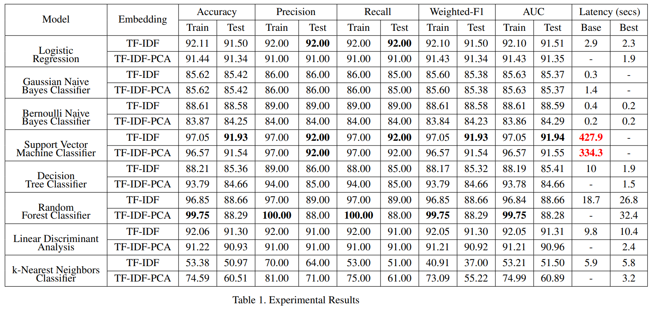
Original Results (Midsem)

Slide 20
Results - Machine Learning Models
Model | Embedding |  | Accuracy |  | Precision |  | Recall
 |  |  | Train | Test | Train | Test | Train | Test
Logistic Regression | TF-IDF |  | 92.11 | 91.50 | 92.00 | 92.00 | 92.00 | 92.00
 | TF-IDF-PCA |  | 91.44 | 91.34 | 91.00 | 91.00 | 91.00 | 91.00
Gaussian Naive Bayes Classifier | Word2Vec |  | 85.73 | 86.01 | 86.00 | 86.00 | 86.00 | 86.00
 | Word2Vec -PCA |  | 85.73 | 86.01 | 86.00 | 86.00 | 86.00 | 86.00
Bernoulli Naive Bayes Classifier | Word2Vec |  | 86.21 | 86.45 | 87.00 | 87.00 | 86.00 | 86.00
 | Word2Vec -PCA |  | 83.87 | 84.25 | 84.00 | 84.00 | 84.00 | 84.00
Support Vector Machine Classifier | TF-IDF |  | 97.05 | 91.93 | 97.00 | 92.00 | 97.00 | 92.00
 | TF-IDF-PCA |  | 96.57 | 91.54 | 97.00 | 92.00 | 97.00 | 92.00
Decision Tree Classifier | TF-IDF |  | 88.21 | 85.36 | 89.00 | 86.00 | 88.00 | 85.00
 | TF-IDF-PCA |  | 93.79 | 84.66 | 94.00 | 85.00 | 94.00 | 85.00
Linear Discriminant Analysis | TF-IDF |  | 92.06 | 91.30 | 92.00 | 91.00 | 92.00 | 91.00
 | TF-IDF-PCA |  | 91.22 | 90.93 | 91.00 | 91.00 | 91.00 | 91.00
k-Nearest Neighbors Classifier | Word2Vec |  | 90.85 | 86.26 | 91.00 | 88.00 | 91.00 | 86.00
 | Word2Vec -PCA |  | 92.15 | 87.18 | 92.00 | 88.00 | 92.00 | 87.00

Slide 21
Results - Machine Learning Models
Model | Embedding |  | Accuracy |  | Precision |  | Recall
 |  |  | Train | Test | Train | Test | Train | Test
Random Forest Classifier | Word2Vec |  | 95.22 | 90.48 | 95.00 | 91.00 | 95.00 | 90.00
 | Word2Vec -PCA |  | 91.48 | 88.69 | 92.00 | 89.00 | 91.00 | 89.00
AdaBoost | TF-IDF |  | 89.48 | 89.24 | 89.00 | 87.00 | 89.00 | 87.00
XGBoost | TF-IDF |  | 85.23 | 87.45 | 86.00 | 85.00 | 85.00 | 85.00
Voting Classifier | TF-IDF |  | 93.25 | 91.42 | 92.00 | 91.00 | 91.00 | 91.00
Stacking Classifier | TF-IDF |  | 92.74 | 91.37 | 91.00 | 90.00 | 90.00 | 89.00
MLP 2-Layer (ReLU) | TF-IDF |  | 93.08 | 91.50 | 90.00 | 90.00 | 90.00 | 89.00
MLP 3-Layer (Identity) | TF-IDF |  | 92.93 | 91.36 | 88.00 | 88.00 | 88.00 | 88.00
MLP 3-Layer (ReLU) | TF-IDF |  | 93.41 | 91.45 | 89.00 | 87.00 | 88.00 | 87.00

Slide 22
Analysis - Machine Learning Models
The best-performing models are LDA, Logistic Regression and the SVM classifier.
SVM showed the best accuracy with a Polynomial kernel, and we report its results. However, on closer analysis, we can see that SVM has a broader gap in its training and testing accuracies, indicating a high variance of the model.
LDA and Logistic Regression offer similar accuracies with lesser chances of the models being overfit.
In our Mid-semester Report, the Random Forest Classifier demonstrated overfitting, reflected in a significant training accuracy versus testing accuracy gap; by imposing maximum depth and pruning trees, we mitigated overfitting, resulting in increased testing accuracy and narrowed the gap.

Slide 23
Analysis - Machine Learning Models
Using different embeddings also immensely helped in improving model performance.
Models like Gaussian and Bernoulli Naive Bayes gave only 55% accuracy with TF-IDF embeddings, while the accuracy increased almost 30 points to 85% accuracy while using Word2Vec Embeddings.
A similar trend was observed for k-nearest Neighbors and Random Forest Classifiers.
Word2Vec embeddings outperform TF-IDF due to their neural network-based generation that yields superior geometric properties in a fixed-dimensional space, significantly benefiting classifiers like Naive Bayes and k-NN.

Slide 24
Analysis - Ensemble Methods
Ensemble models are based on the concept of combining multiple models (weak learners), each with high diversity.
We employed five ensemble techniques, i.e. Random Forest Classifier, AdaBoost, XGBoost, Voting and Stacking Classifier.
Voting and Stacking Classifiers gave the highest accuracies, and that comes intuitively as they correct the mistakes of weaker classifiers.
An interesting anomaly is observed wherein our test accuracy using the XGBoost Classifier is higher than its training accuracy.

Slide 25
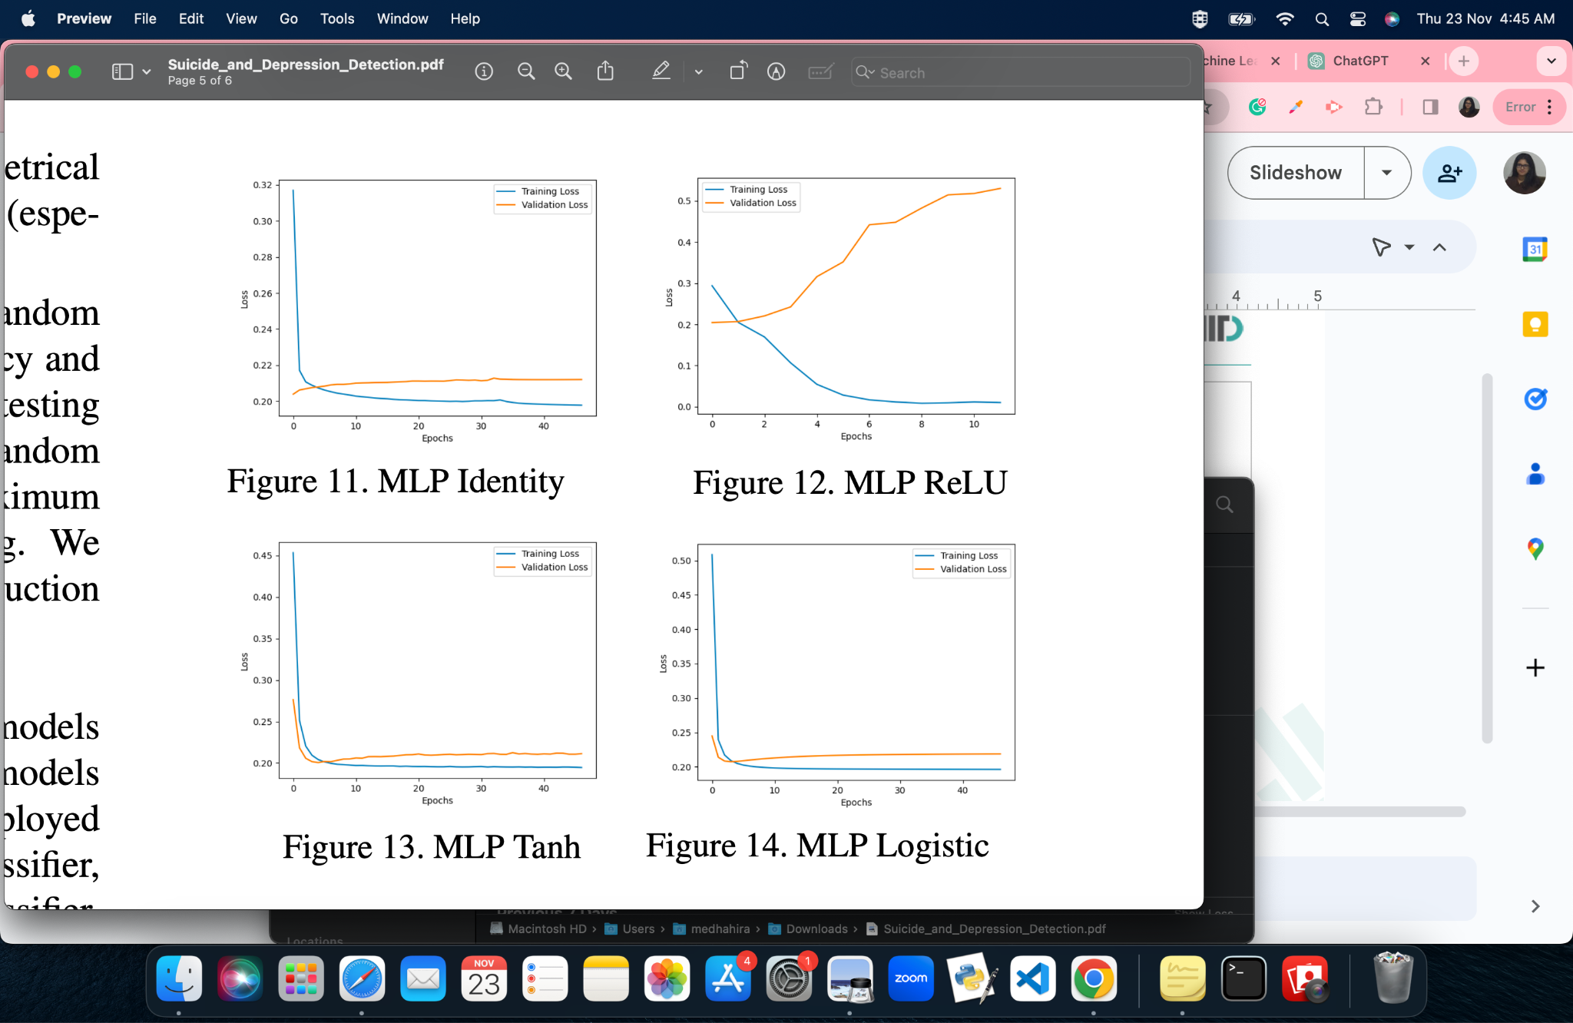
Analysis - MLP
MLP Identity
MLP ReLU
MLP Tanh
MLP Logistic

Slide 26
Analysis - MLP
We used this deep learning technique and trained our dataset using two hidden layers of size (128,64) and then three hidden layered of size (128,64,32) MLP.
We got an accuracy of 91.50% using 2 layer MLP with ReLU activation function and 91.45% using 3 layer MLP with ReLU. Identity function gave a test accuracy of only 91.36%
The figures show the different activation function's train and validation losses of MLP with hidden layers.
As we see ReLU's validation loss is increasing. This is due to the problem of exploding gradients.
Mentioned here are some hyper-parameters chosen:
2 layer MLP (ReLU): {'batch_size': 32, 'learning_rate_init': 0.001}
3 layer MLP (ReLU): {'batch_size': 64, 'learning_rate_init': 0.001}
3 layer MLP (Identity): {'batch_size': 128, 'learning_rate_init': 0.1}

Slide 27
About the Reddit Bot
Bot Development: Developed a specialized Reddit bot using the Python Reddit API Wrapper (PRAW) coupled with our project's most efficient machine learning model.
Suicidal Ideation Prediction: Focused on predicting suicidal ideation on the Reddit platform, the bot employs advanced natural language processing techniques to preprocess post content.
ML Model Integration: Utilizes the project's top-performing machine learning model for assessment, ensuring accurate risk prediction based on the processed post content.
Supportive Intervention: When a potential risk is detected, the bot intervenes by providing mental health resources and supportive messages. For non-concerning content, it designates the post as safe, contributing to a supportive online environment.

Slide 28
Demo of the Reddit Bot
https://www.youtube.com/watch?v=7NHZzQAnS1k

Slide 29
Conclusion and Learning
Thus, we conclude our project wherein we tried various ML, Ensemble and Neural Network-based models to aid the process of Suicide Ideation Detection from Social Media Conversations.
We compared various models and better understood the bias-variance tradeoff to better understand performance on Out-of-Distribution Data.
We also learnt deployment of ML models on social media websites by developing a Reddit Bot which can in real-time detect suicide ideation from Reddit Posts.
We greatly value this experience and hope to improve upon our work by trying more advanced architectures and tougher datasets.

Slide 30
Individual Member Contributions
All the members contributed equally to the work and helped each other in making edits to the codes and writing this report. The individual contributions listed below are only representations of the assignments of tasks to each team member.
• Arnav: ADABoost, XGBoost, Text pre-processing, EDA, Logistic Regression, Naive Bayes, Linear Discriminant Analysis, k-NN classifier, Report Writing, Principal Component Analysis.
• Medha: MLP, Voting Classifier, Stacking Classifier, TF-IDF embeddings, GLoVe Embeddings, EDA, Decision Tree Classifier, Random Forest Classifier, Report Writing, Presentation
• Siddharth: Reddit Bot (Model Deployment), Text pre-processing, Transformer and Word2Vec Embeddings, Principal Component Analysis, Report Writing and Presentation

Slide 31
THANK YOU!

